Slide 1
Advanced Data Structures

Slide 2
Goals
To learn about the set and map data types
To understand hash tables
To be able to program hash functions
To learn about binary trees and BSTs
To be able to use tree sets and tree maps
To become familiar with the heap data structure and its use for priority queues
To understand the graph data structure and standard operations on graphs.

Slide 3
Sets
Set: unordered collection of distinct elements
Elements can be added, located, and removed
Sets don't have duplicates (multiset collections do)

Slide 4
Fundamental Operations on a Set
Adding an element
  Adding an element has no effect if the element is already in the set
Removing an element
  Attempting to remove an element that isn't in the set is silently ignored
Containment testing (does the set contain a given object?)
Listing all elements (in arbitrary order)

Slide 5
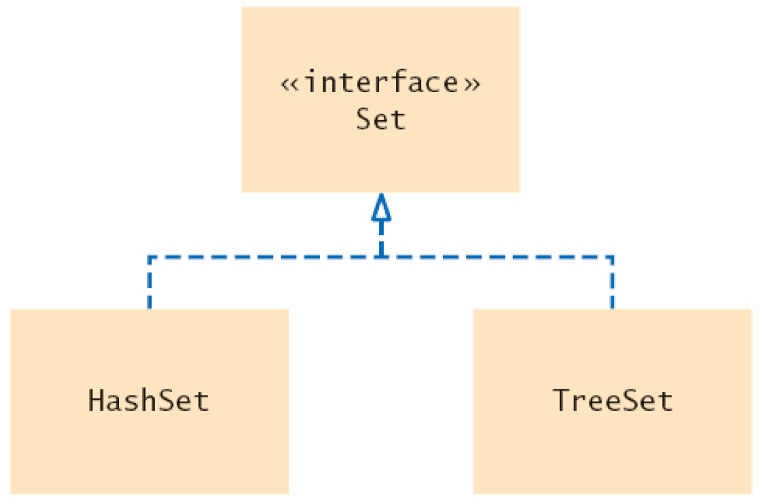
Set Classes and Interface in the Standard Library
Set Classes and Interfaces in the Standard Library

Slide 6
Example
Use an iterator to visit all elements in a set
A set iterator does not visit the elements in the order in which they were inserted
An element can not be added to a set at an iterator position
A set element can be removed at an iterator position
H:\AdvCompProg\SourceCode\03AdvDS\set\SetDemo.java
\SetDemoFactored.java

Slide 7
Maps
A map keeps associations between key and value objects
Mathematically speaking, a map is a function from one set, the key set, to another set, the value set
Every key in a map has a unique value
A value may be associated with several keys
Classes that implement the Map interface
  HashMap
  TreeMap

Slide 8
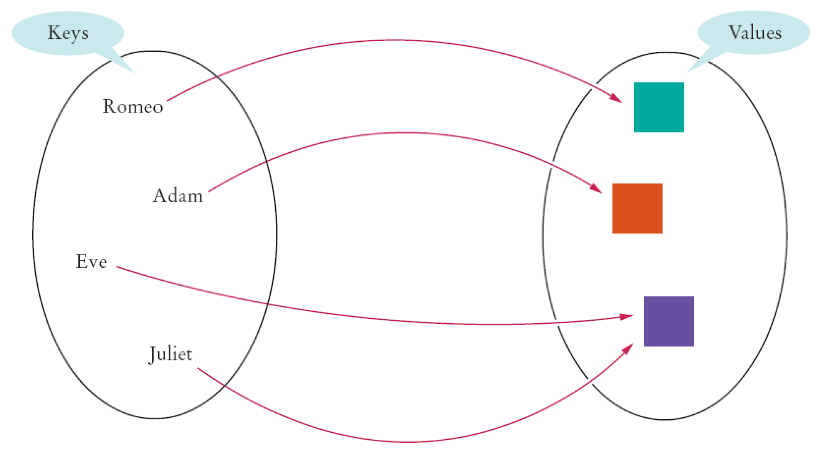
An Example of a Map
An Example of a Map

Slide 9
Hash Sets and Tables
Hashing can be used to find elements in a data structure quickly without making a linear search
A hash table can be used to implement sets and maps
A hash function computes an integer value (called the hash code) from an object

Slide 10
Hash Tables
A good hash function minimizes collisions–identical hash codes for different objects
To compute the hash code of object x:
Java's hashCode() workings
H:\JCoffeyHDrive\advcompprog\ExamplePrograms\Hash\Hash.java
int h = x.hashCode();

Slide 11
Sample Strings and Their Hash Codes
String | Hash Code
"Adam" | 2035631
"Eve" | 70068
"Harry" | 69496448
"Jim" | 74478
"Joe" | 74676
"Juliet" | −2065036585
"Katherine" | 2079199209
"Sue" | 83491

Slide 12
Implementation of a Hash Table
To implement
  Make an array (either to hold the objects OR to hold references to lists of objects)
  Generate hash codes for objects
  Insert each object at the location of its hash code
To test if an object is contained in the set
  Compute its hash code
  Check if the item can be found at the array position with that hash code

Slide 13
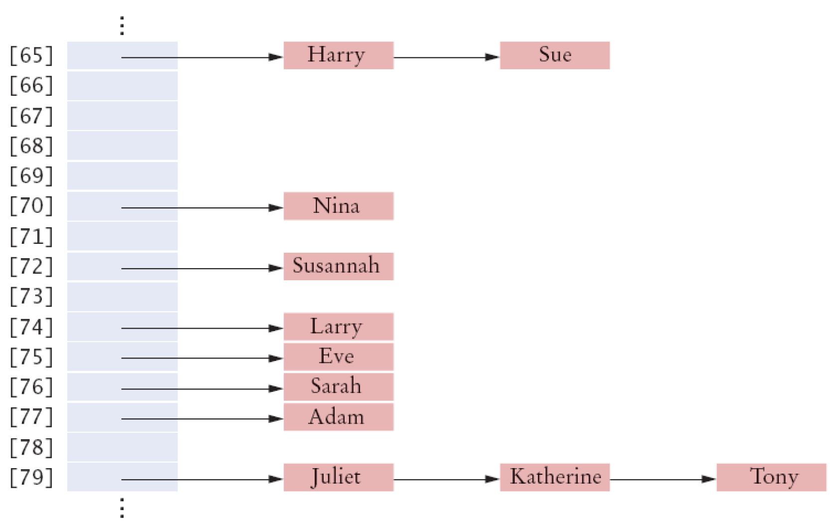
Externally Chained Hash Table

Slide 14
Algorithm for Finding an Object x in a Hash Table
Get the index h from the hash function – the position of the item in the table
  Compute the hash code
  Reduce it modulo the table size
Iterate through the elements of the bucket at position h
  For each element in the bucket, check whether it is equal to x
If a match is found among the elements of that bucket, then x is in the set
  Otherwise, x is not in the set

Slide 15
Hash Tables
A hash table can be implemented as an array of buckets
Buckets hold sequences of nodes that contain elements with the same hash code
If there are few collisions, then adding, locating, and removing hash table elements takes constant time
  Big-Oh notation: O(1)

Slide 16
Computing Hash Codes
A hash function computes an integer hash code from an object
Choose a hash function so that different objects are likely to have different hash codes.
\SourceCode\03AdvDs\Hash\

Slide 17
Computing Hash Codes
Bad choice for hash function for a string
  Adding the unicode values of the characters in the string
  Because permutations ("eat" and "tea") would have the same hash code
int h = 0;
for (int i = 0; i < s.length(); i++)
h = h + s.charAt(i);

Slide 18
Hash Maps
In a hash map, only the keys are hashed
The keys need compatible hashCode and equals method

Slide 19
Binary Trees
Binary trees have these characteristics:
  a designated root node
  for each node in a binary tree, there might be zero, one, or two child nodes
  A node with no child nodes is termed a leaf node
  The height of a binary tree is the number of links from the root node to the node deepest in the tree
Binary Search Trees are ordered binary trees

Slide 20
A Binary Tree Class
public class BinaryTree implements Comparable
{
protected BinaryTreeNode root = null;
public BinaryTree()
public void clear()
public boolean isEmpty()
public void insert(Comparable el)
public Comparable search(Comparable el)
public void preorder() {
public void inorder() {
public void postorder()
protected void visit(BinaryTree p)
public void deleteByCopying(Comparable el)
public void iterativePreorder()
// etc . . .
}

Slide 21
Constructors
public class BinaryTreeNode
{
private Comparable el;
private BinaryTreeNode left, right;
public BinaryTreeNode() {
left = right = null;
}
}
public BinaryTreeNode(Comparable elem, BinaryTreeNode lt, BinaryTreeNode rt)
{
el = elem;
left = lt;
right = rt;
}

Slide 22
Tree Traversals
Print the tree elements in sorted order:
  visit the left subtree
  process the data in the current node
  visit the right subtree

Slide 23
Tree Traversals
public void preorder() {
preorder(root);
}
protected void preorder(BinaryTreeNode p) {
if (p != null) {
visit(p);
preorder(p.left);
preorder(p.right);
}
protected void inorder(BinaryTreeNode p) {
if (p != null) {
inorder(p.left);
visit(p);
inorder(p.right);
}
}

Slide 24
Tree Traversals
protected void postorder(BinaryTreeNode p)
{
if (p != null)
{
postorder(p.left);
postorder(p.right);
visit(p);
}
}

Slide 25
Example
Let's try this out with this tree:
The algorithm tells us to
  Print the left subtree of Juliet; that is, Diana and descendants
  Print Juliet
  Print the right subtree of Juliet; that is, Tom and descendants
Juliet
Diana
Tom
Harry
Romeo
Zelda

Slide 26
Example
How do you print the subtree starting at Diana?
  Print the left subtree of Diana. There is nothing to print
  Print Diana
  Print the right subtree of Diana, that is, Harry

Slide 27
Tree Traversal – Expression Trees
The first tree ((3 + 4) * 5) yields
3 4 + 5 *
Whereas the second tree (3 + 4 * 5) yields
3 4 5 * +

Slide 28
Binary Search Trees
Binary search trees allow for fast insertion and removal of elements
They are specially designed for fast searching
A binary tree consists of nodes, each of which has zero, one, or two child nodes

Slide 29
Binary Search Trees
All nodes in a binary search tree fulfill the property that:
  Descendants to the left have smaller data values than the node data value
  Descendants to the right have larger data values than the node data value **
  ** < or > not <= >=. What does this mean?

Slide 30
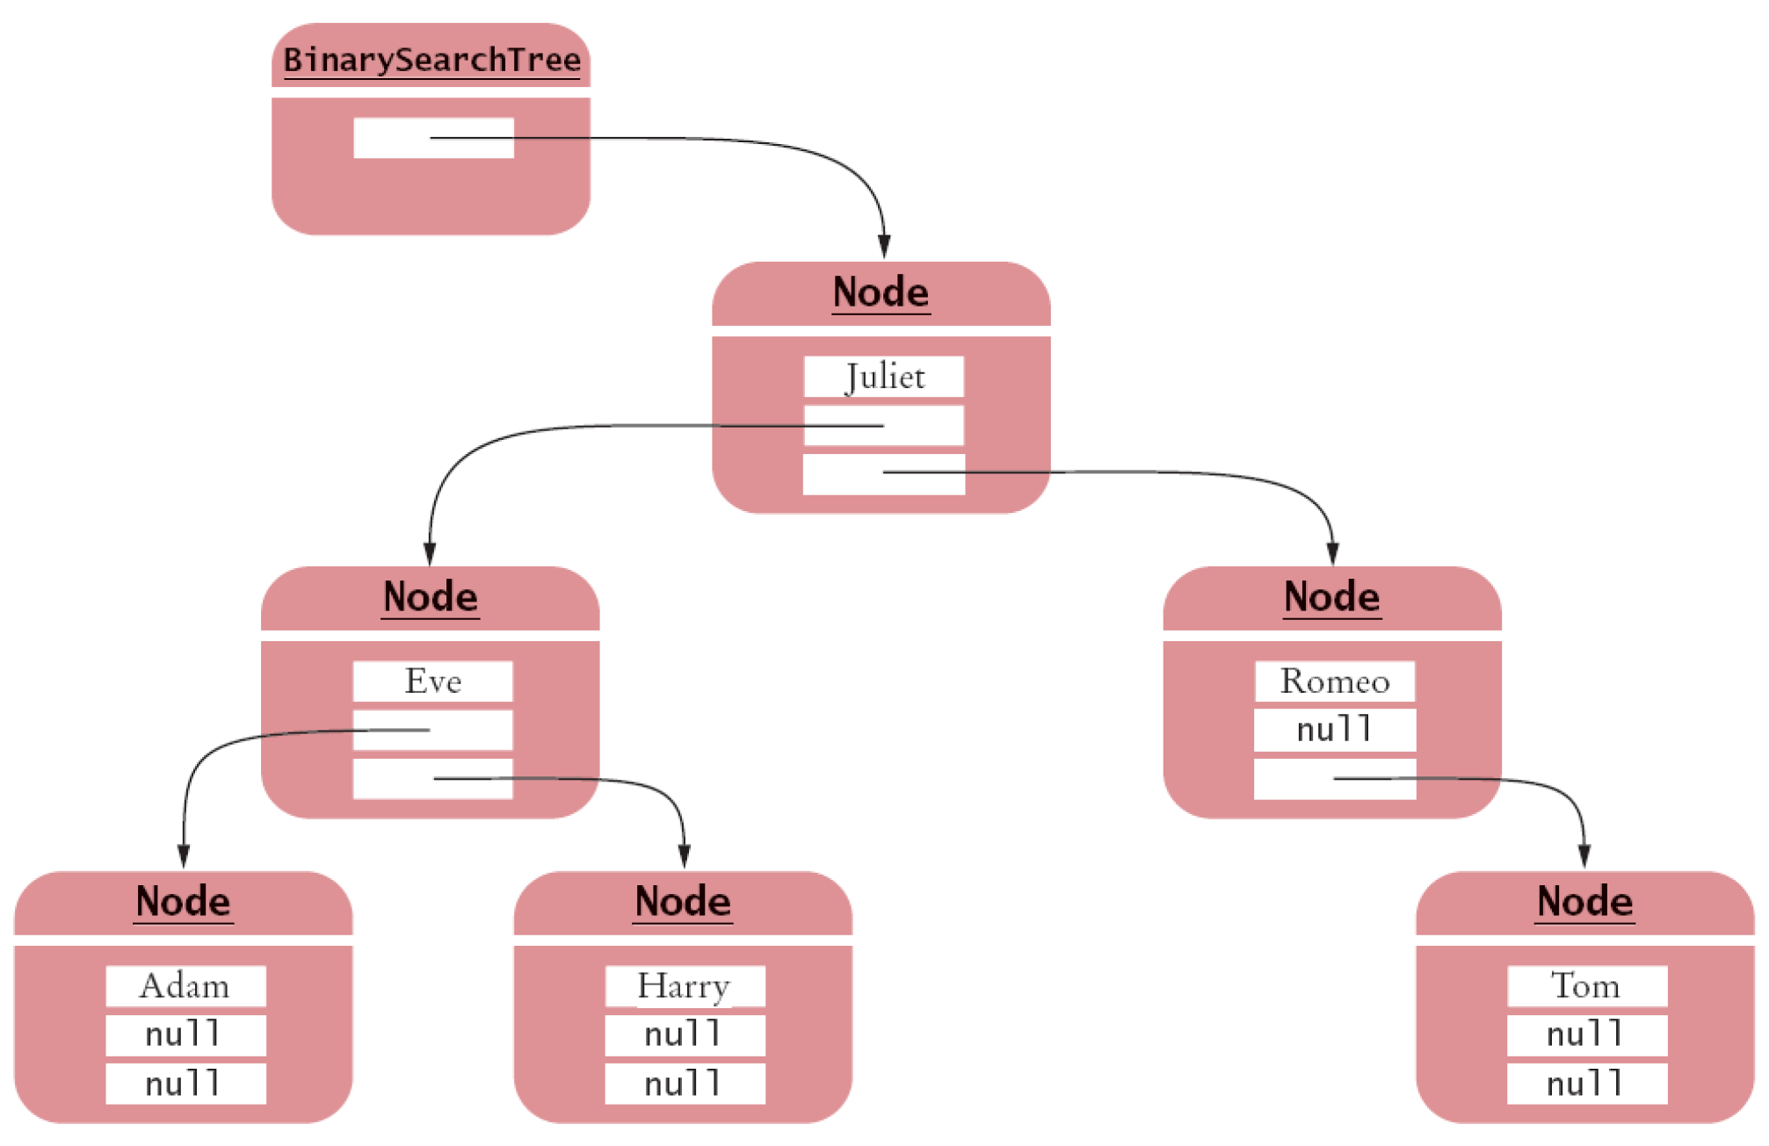
A Binary Search Tree
A Binary Search Tree

Slide 31
Implementing a Binary Search Tree
Implement a class for the tree containing a reference to the root node
Implement a class for the nodes
  A node contains two references (to left and right child nodes)
  A node contains a data field
  The data field has type Comparable, so that you can compare the values in order to place them in the correct position in the binary search tree

Slide 32
Insertion Algorithm
If you encounter a non-null node reference, look at its data value
  If the data value of that node is larger than the one you want to insert,
  continue the process with the left subtree
  If the existing data value is smaller,
  continue the process with the right subtree
If you encounter a null node pointer, replace it with the new node

Slide 33
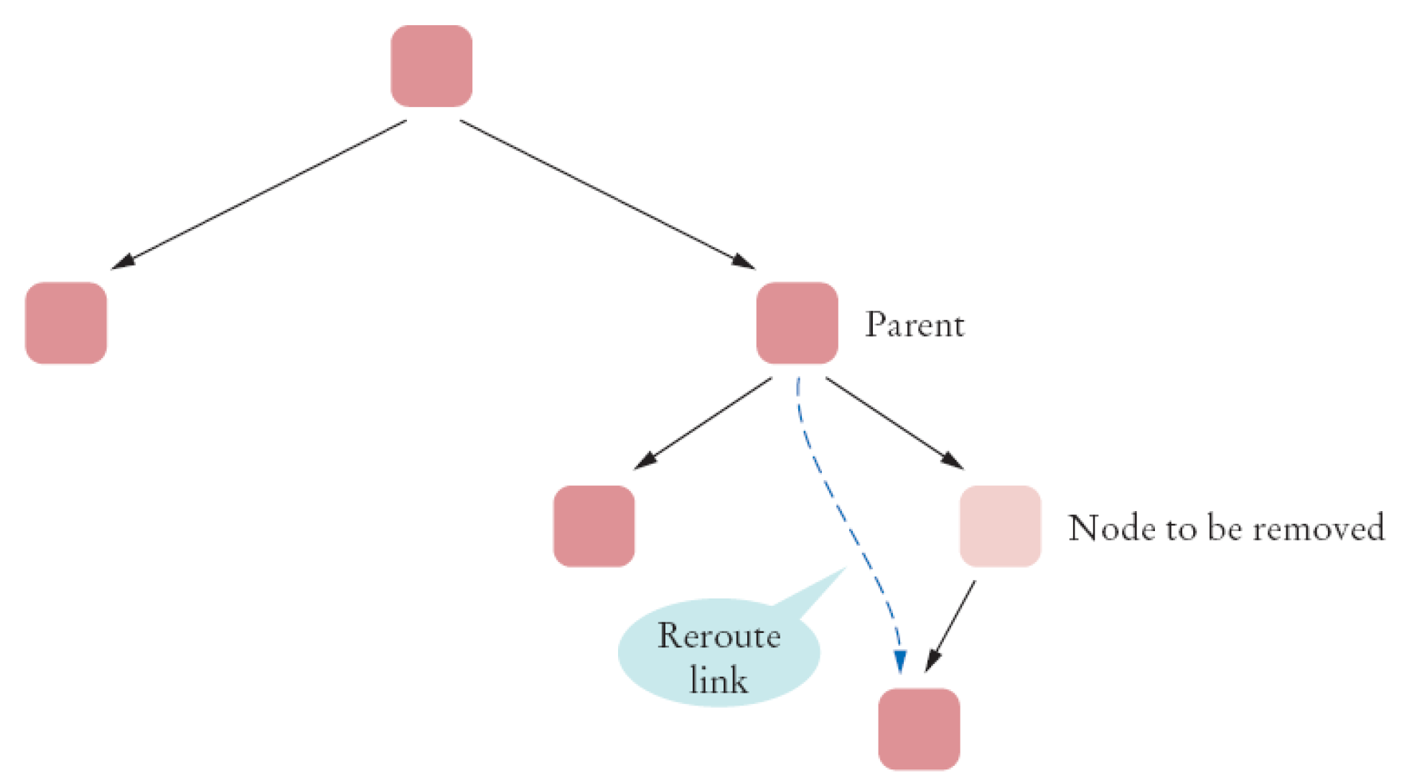
Removing a Node with One Child

Slide 34
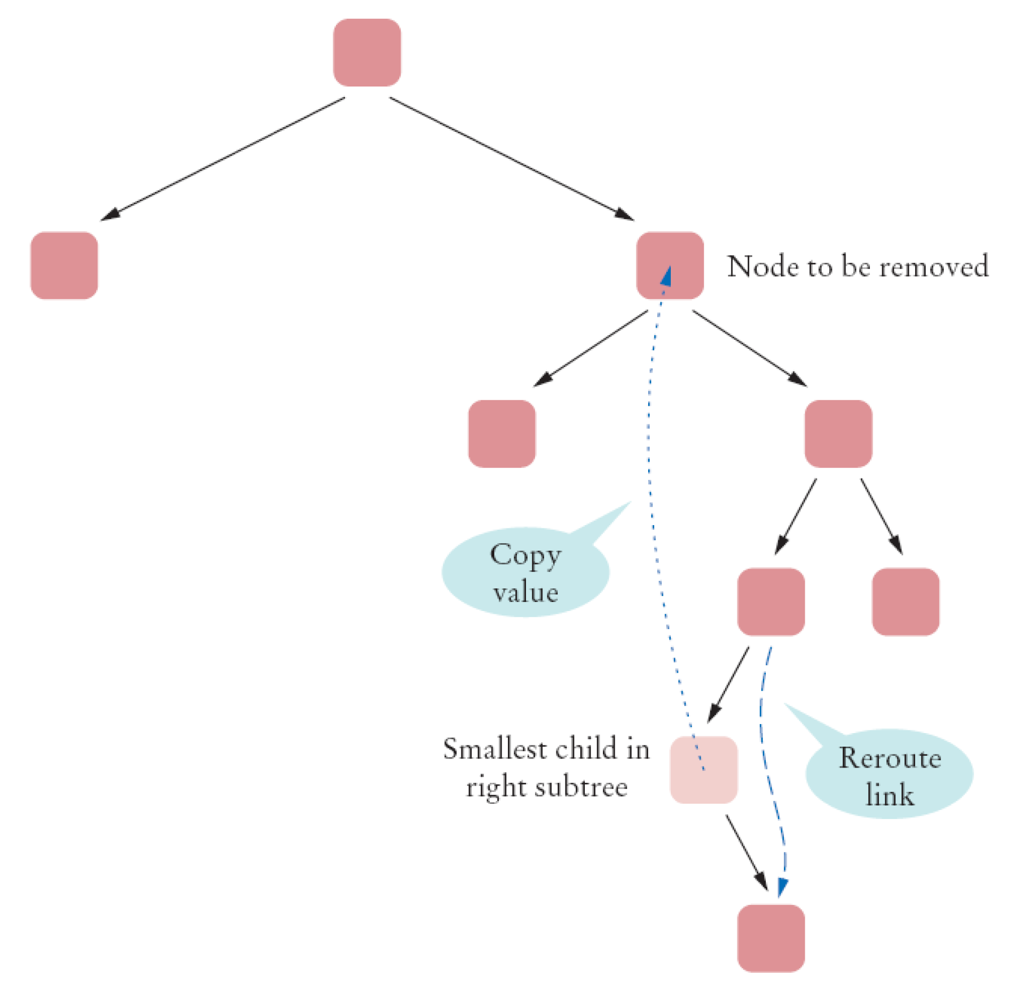
Removing a Node with Two Children

Slide 35
Binary Search Trees
Balanced tree: each node has approximately as many descendants on the left as on the right
If a binary search tree is balanced, then adding an element takes O(log(n)) time
If the tree is unbalanced, insertion can be slow
  Perhaps as slow as insertion into a linked list

Slide 36
To Use a TreeSet
Either your objects must implement Comparable interface
Or you must provide a Comparator object

Slide 37
To Use a TreeMap
Either the keys must implement the Comparable interface
Or you must provide a Comparator object for the keys Example Comparator
There is no requirement for the values

Slide 38
Priority Queues
A priority queue collects elements, each of which has a priority
Example: collection of work requests, some of which may be more urgent than others
When removing an element, element with highest priority is retrieved
  Customary to give low values to high priorities, with priority 1 denoting the highest priority

Slide 39
Priority Queues
Standard Java library supplies a PriorityQueue class
A data structure called a heap is useful for the implementation of priority queues

Slide 40
Example
Consider this sample code:
When calling q.remove() for the first time, the work order with priority 1 is removed
Next call to q.remove() removes the order with priority 2
\SourceCode\03AdvDS\pqueue\
PriorityQueue<WorkOrder> q = new PriorityQueue<WorkOrder>;
q.add(new WorkOrder(3, "Shampoo carpets"));
q.add(new WorkOrder(1, "Fix overflowing sink"));
q.add(new WorkOrder(2, "Order cleaning supplies"));

Slide 41
Heaps
A heap (a min-heap or max-heap) is a binary tree with two special properties
  It is almost complete
    All nodes are filled in, except the last level may have some nodes missing toward the right
  The tree fulfills the heap property
    All nodes store values that are either all at least (max-heap) or at most (min-heap) as large as the values stored in their descendants
The Heap property ensures that the highest priority element is stored in the root

Slide 42
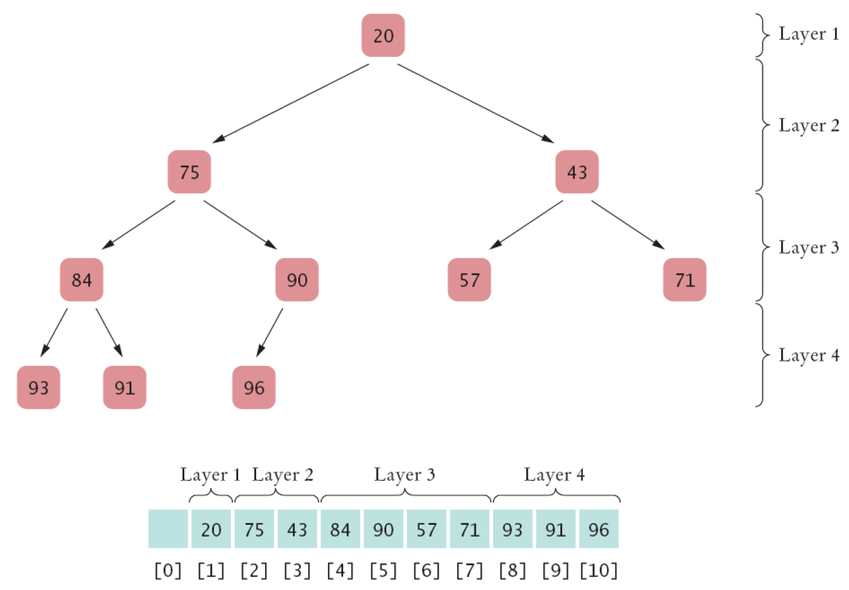
Storing a Heap in an Array
Storing a Heap in an Array

Slide 43
Differences between a Heap and a Binary Search Tree
The shape of a heap is very regular
  Binary search trees can have arbitrary shapes
In a heap, the left and right subtrees both store elements that are larger than the root element
  In a binary search tree, smaller elements are stored in the left subtree and larger elements are stored in the right subtree

Slide 44
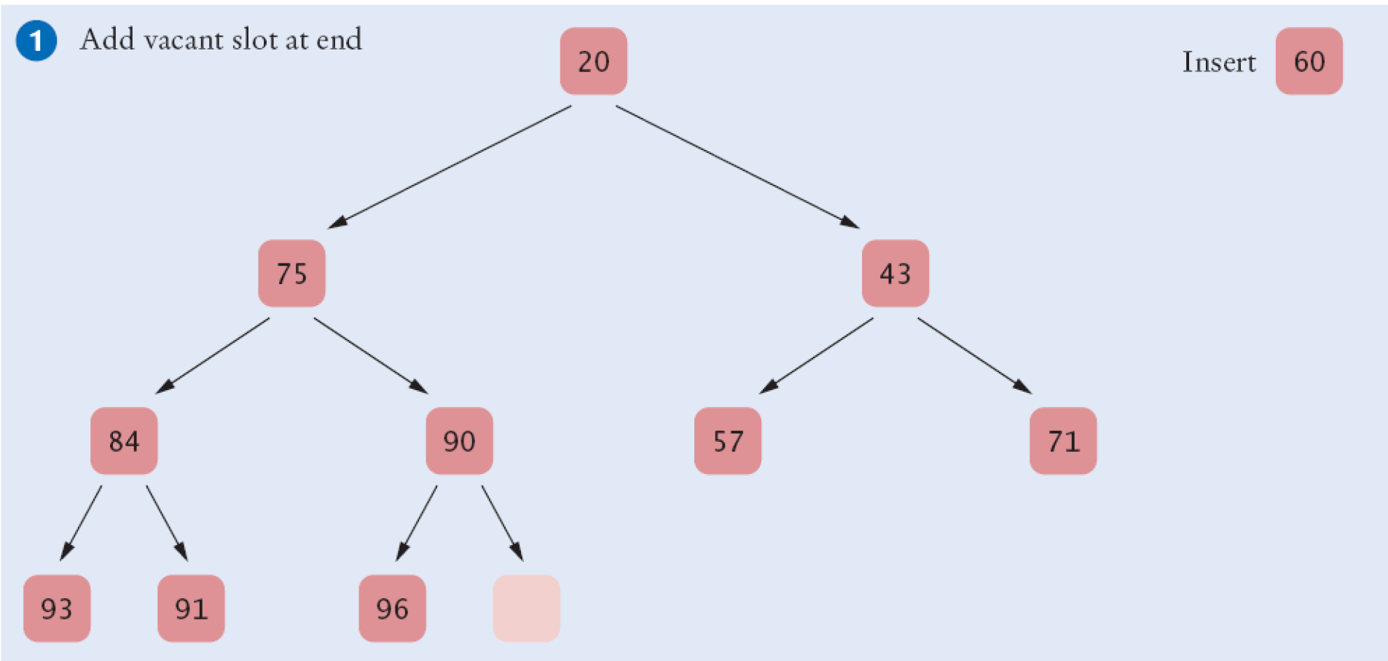
Inserting a New Element in a Heap
Increment the size of the heap to create a vacant slot to the end of the tree
Inserting a New Element in a Heap

Slide 45
Inserting a New Element in a Heap
2. Place the new item there and percolate up.
  Move the parent value into the vacant slot, and move the vacant slot up if the parent is larger than the item in the slot
  Repeat this process as long as the parent of the vacant slot is larger than the element to be inserted

Slide 46
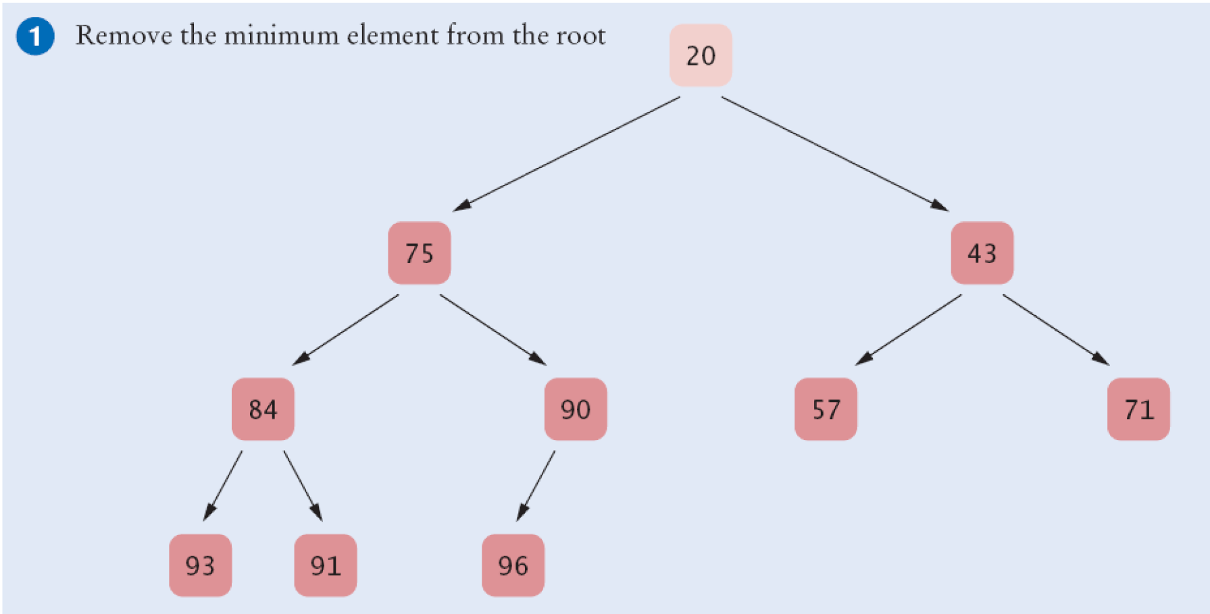
Removing the highest priority value Node from a Heap
Extract the root node value

Slide 47
Removing the highest priority value Node from a Heap
96
2. Place the last item at the top and percolate down

Slide 48
Heap Efficiency
Thus, insertion and removal operations take O(log(n)) steps
Heap's regular layout makes it possible to store heap nodes efficiently in an array

Slide 49
The Heapsort Algorithm
Based on inserting elements into a heap and removing them in sorted order
This algorithm is an O(n log(n)) algorithm:
  Each insertion and removal is O(log(n))
  These steps are repeated n times, once for each element in the sequence that is to be sorted

